Slide 1
SYNTHETIC EQUITY
A POWERFUL COMPENSATION
AND RETENTION
SOLUTION

Slide 2
01
WHY SYNTHETIC EQUITY IS IMPORTANT TO USE NOW
KEY TAKEAWAYS
02
COMMON APPLICATIONS
03
WHAT IS SYNTHETIC EQUITY & HOW DOES IT DIFFER FROM TRUE EQUITY?
04
KEY BENEFITS
SYNTHETIC EQUITY PROVIDES INDEPENDENT WEALTH MANAGERS WITH A SUITE OF POWERFUL TOOLS PREVIOUSLY THOUGHT TO BE AVAILABLE ONLY TO LARGE CORPORATIONS.​
05
ESSENTIAL PLANNING ELEMENTS FOR YOUR STRATEGY
06
STEPS YOU CAN TAKE TO DESIGN YOUR COMPENSATION SYSTEM AND CREATE A GROWING, VALUABLE BUSINESS

Slide 3
TODAY’S
PRESENTERS
STUART SMITH, JD
KEM TAYLOR, CBEC
Senior Consultant
Senior Consultant
Notes:
Update depending on who is presenting

Slide 4
WHY SYNTHETIC EQUITY
IS IMPORTANT
FLEXIBILITY AND CUSTOMIZATION ARE KEY TO BUILDING VALUE. ADVANTAGES OF USING SYNTHETIC EQUITY INCLUDE:
Preserves cash flow
Enhances your ability to recruit, retain and reward talented advisors & staff
Helps you look to the future and reward tenure, loyalty, and performance ​
Encourages participants to “think like an owner” without buying actual stock​

Slide 5
UTILIZING
FLEXIBLE SOLUTIONS TO RETAIN AND INCENTIVIZE TOP TALENT
SYNTHETIC EQUITY
An owner who wants to share the economic value of equity, but not equity itself​
A key employee who wants to receive ownership-like returns but is unable or unwilling to take on the financial risk of buying and paying for equity​
An owner who wants to retire and sell his or her practice in five years or less and wants to reward one or more key employees ​
To create golden handcuffs to retain key employees​
A key employee who desires to be an owner but does not have the necessary licenses or qualifications to be a full equity partner​
A key employee who is young and eager for ownership but isn’t yet ready to take on a leadership role​
The business has not yet taken the steps to own the client revenue

Slide 6
A SPECTRUM
OF INCENTIVES
COMPENSATION
SYNTHETIC EQUITY
EQUITY
SHORT-TERM REWARD
LONG TERM REWARD

Slide 7
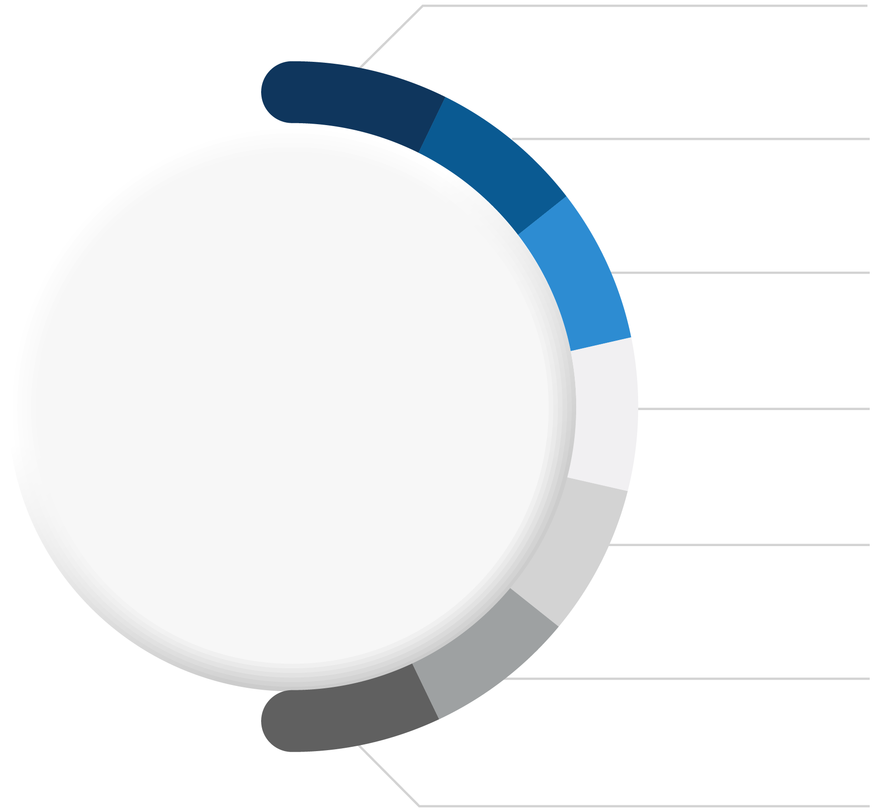
GOVERNANCE
VOTING RIGHTS
LIMITED LIABILITY
DEFINING
TRUE EQUITY
PROFITS
CAPITAL APPRECIATION
LTCG’S
FINANCIAL RECORDS

Slide 8
KEY BENEFITS OF
FLEXIBILITY
SYNTHETIC EQUITY
Vesting schedules​
Adjustable payment terms and timing​
Can be measured by many different metrics, or combinations​
Added flexibility for​ advisors who operate as​ a Partnership
FOR OWNERS
ALIGNMENT
Aligns owners and employees to focus on growth and shareholder value ​
No money changes hands if goals are not met

Slide 9
INITIAL
CONSIDERATIONS
ESSENTIAL QUESTIONS
What outcomes or behaviors do you want to incentivize? ​
Who will participate in the plan?​
When is the plan to be paid out?​
How much are you wiling to pay?

Slide 10
TYPES OF
PLANS
APPRECIATION PLANS
FULL VALUE PLANS
PERFORMANCE UNIT PLANS
Stock Appreciation Rights (SAR)​
Profits Interest
Phantom Stock Plan (PSP) ​
Change in Control
Long-term Incentive Plan (LTIP)​
Long-term Equity Participation Plan ​

Slide 11
SET YOUR
GOALS
MAKE SURE YOUR PLAN IS:
Easy to understand
Clear
Simple in execution
And Management
Designed to achieve business goals

Slide 12
A PLAN FOR
GROWTH & PROFITABILITY
REMEMBER TO
Focus on “how” and not “how much.” ​
Start with a bottom-line up perspective. ​
Create scalable compensation for both producers and owners. ​
Shift the role of variable comp to profit distributions. ​
Balance wages for work against return on investment. ​
Reserve true equity for those who genuinely make a difference and will commit their careers to the process of building a sustainable, valuable business.
GUIDANCE FOR STRUCTURING YOUR COMPENSATION SYSTEM

Slide 13
HOW TO
GET STARTED
NEXT STEPS
Schedule a consultation
Perform an Assessment​
Design a plan
Analyze it
Document it

Slide 14
LET’S START A
CONVERSATION
THANK YOU FOR JOINING!
Ready to take the next step? Scan the code to schedule a consultation.
Notes:
This QR code currently goes to the standard book a consult linked on the website: https://meetings.hubspot.com/marketing-fp-transitions/schedule-a-consultation
Reach out to Shelby if the QR code should be linked elsewhere

